Slide 1
Django app part-2
Django basic to advance course
In Nepali

Slide 2
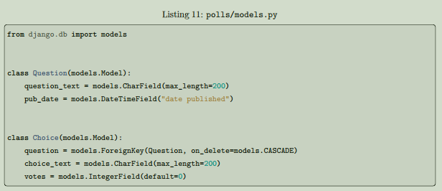
This tutorial begins where Tutorial 1 left off. We’ll set up the database, create your first model, and get a quick introduction to Django’s automatically-generated admin site.
Use $python manage.py migrate to make the database table . This command looks in the apps installed and create a table for that app.
Models :
: Models are the definitive source of information ; means it will map out the table in database.

Slide 3
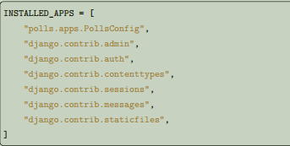
Activating models
That small bit of model code gives Django a lot of information. With it, Django is able to:
• Create a database schema (CREATE TABLE statements) for this app.
• Create a Python database-access API for accessing Question and Choice objects. But first we need to tell our project that the polls app is installed.
To include the app in our project, we need to add a reference to its configuration class in the INSTALLED_APPS setting. The PollsConfig class is in the polls/apps.py file, so its dotted path is 'polls.apps.PollsConfig’. Edit the mysite/settings.py file and add that dotted path to the INSTALLED_APPS setting. It’ll look like This:
$ python manage.py makemigrations app_name
This command is used for creating the database and making sure that the app is installed with models registered.
After that run migrate command
Now, let’s hop into the interactive Python shell and play around with the free API Django gives you. To invoke the Python shell, use this command:
$ python manage.py shell

Slide 4
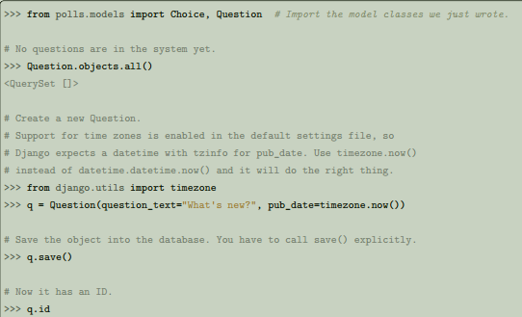
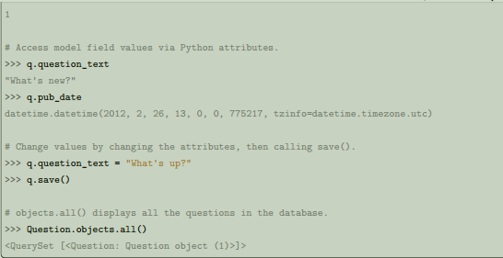
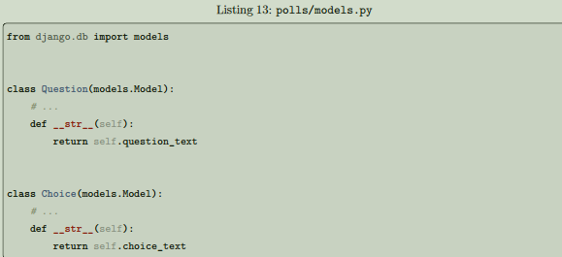
Wait a minute. <Question: Question object (1)> isn’t a helpful representation of this object. Let’s fix that by editing the Question model (in the polls/models.py file) and adding a __str__() method to both Question and Choice:

Slide 5
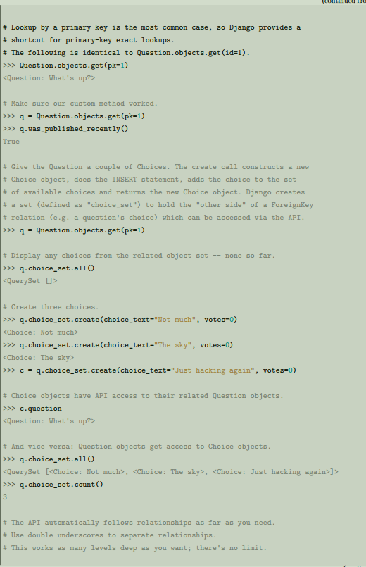
Introducing the Django Admin
Creating an admin user
First we’ll need to create a user who can login to the admin site. Run the following command:
$ python manage.py createsuperuser
Enter your desired username and press enter.
Username: admin
You will then be prompted for your desired email address:
Email address: admin@example.com
The final step is to enter your password. You will be asked to enter your password twice, the second time as
a confirmation of the first.
Password: **********
Password (again): *********
Superuser created successfully.

Slide 6
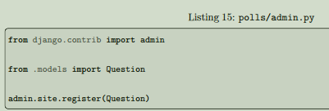
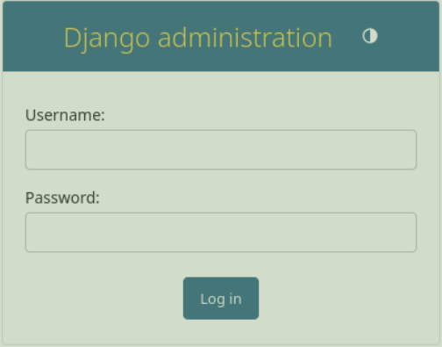
Start the development server
The Django admin site is activated by default. Let’s start the development server and explore it.
If the server is not running start it like so:
$ python manage.py runserver
Now, open a web browser and go to “/admin/” on your local domain – e.g., http://127.0.0.1:8000/admin/. You
should see the admin’s login screen:
Make the poll app modifiable in the admin
But where’s our poll app? It’s not displayed on the admin index page. Only one more thing to do: we need to tell the admin that Question objects have an admin interface. To do this, open the polls/admin.py file, and edit it to look like this:

Slide 7

Thank you for watching 😊

